Slide 1

COMBINING PARSONS PROBLEMS & SERIOUS GAMES FOR LEARNING PROGRAMMING
1
ONYEDIKACHI KALU
BSc HONOURS THESIS STUDENT
ONTARIO TECH UNIVERSITY
Notes:
Good Day my name is Onyedikachi Kalu
Supervised by Jeremy Brabury
Assisted by Michael Miljanovic

Slide 2
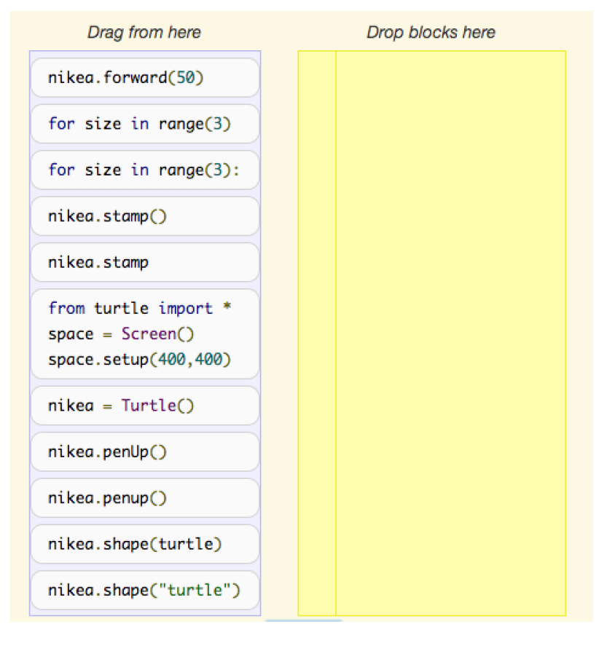
PARSONS PROBLEM
2
The user is presented with randomly ordered code snippets that have to be reordered to solve a programming task.
Notes:
In a Parsons problem, the learner places mixed-up code blocks in the correct order to solve a problem.
Parsons problems can be used for both practice and assessment in programming courses.
Parsons problem can be excellent tool for learning and practice, but it could also lead to frustration; this is where Adaptive Parsons Problems come in
Adaptive Parsons Problem provides help and reduces frustration levels
Intra = problem is dynamically made easier
Inter = the next problem is easier
Distractions = An extra layer of difficulty to test

Slide 3

THESIS GOAL
3
Using Parsons Problem Principles, create a unity game that allows students to learn and practice basic programming

Slide 4
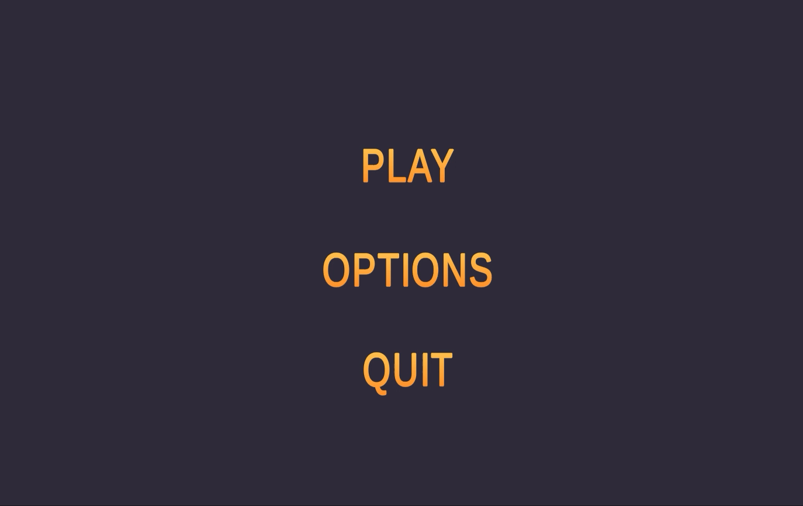
COACH SYNTAX
4
Designed in Unity

Slide 5

WHAT’S NEXT
5
Animations (Febuary 20)
Multiple levels (January 31)
Integrating help features (March 5)
Writing thesis (April 20)

Slide 6
COMBINING PARSONS PROBLEMS & SERIOUS GAMES FOR LEARNING PROGRAMMING
6
ONYEDIKACHI KALU
BSc HONOURS THESIS STUDENT
ONTARIO TECH UNIVERSITY
Notes:
Good Day my name is Onyedikachi Kalu
Supervised by Jeremy Brabury
Assisted by Michael Miljanovic

